Slide 1

CSE 464 : Software Quality Assurance and Testing
Introduction to Bug Management
Janaka Balasooriya

Slide 2
Bug Management – Once bugs are found, what do we do?

Slide 3
Reporting Bugs – Anatomy of a Bug Report
Reporting bugs is an important process. Bug handing involves many and credible bug reporting is imperative.
Your bug report should have necessary information to understand and fix the bug.
Typically a bug report consists of
  a) Title
  b) Description
  c) Status
  d) Version Number
  e) Feature Area
  f) Reproduction steps
  g) Assignment
  h) Severity
  i) Customer Impact
  j) Environment
  k) Resolution

Slide 4
Bug Workflow
1. Report the bug
2. Confirm the bug - Bug Verification
3. Programmer evaluates the bug and fixes it, or not to fix it due to various reasons such as bug is not reproducible, not a credible bug…etc
  The process of deciding which bugs to fix and which to leave in the product is called bug triage.
4. Programmer decides not to fix it and sends it to the project manager
5. If testers and programmers disagree whether a bug should be fixed: Send it to a project team (representatives of the key stakeholder groups) reviews bugs. Such a team is called a Triage team
6. If the bug is fixed, the programmers mark the bug fixed in the bug tracking system
7. The test group retests the fixed bugs and close or reopen

Slide 5
Bug Workflow - Video
Listen to Lecture 1 and 6 of the BBST BUG ADVOCACY course : Basic Concepts and Writing a bug report @
https://bbst.courses/videos/
Try to prepare a 1 page summary of the lecture “Lecture 6 - Writing Clear Bug Reports”

Slide 6
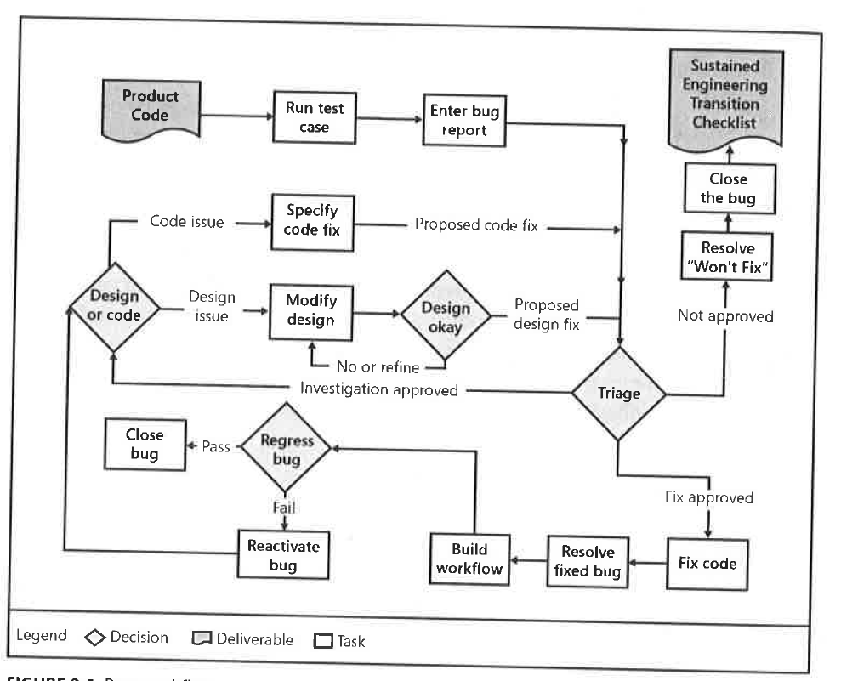
Bug Workflow at Microsoft

Slide 7
Bug Workflow – Open Office
Open office bug workflow system is slightly deferent than the Microsoft Bug Workflow. However, fundamental steps are the same.
Issue Reporting and Bug fixing
http://www.openoffice.org/qa/ooQAReloaded/ooQA-ReportBugs.html
Bug Fixing
http://qa.openoffice.org/ooQAReloaded/ooQA-IssueRules.html

Slide 8
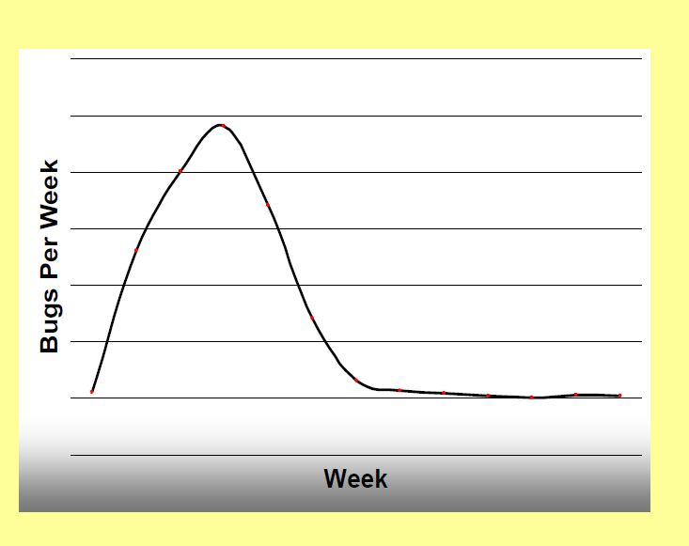
How Much Testing Should Be Performed?
Various parameters are used to determine if the product is ready to be delivered. One of the most commonly used quantitative approach is to measure the “Defect Arrival Rate”.
The Weibull Curve
http://testingeducation.org/BBST

